Slide 1

Open Science using the statistical package JASP
Section methodology and statistics/faculty social and behavioral sciences
Developed by Herbert Hoijtink
H.Hoijtink@uu.nl
Presented by Hanne Oberman
h.i.oberman@uu.nl
Notes:
Update alle slides (circle appearance) a la the slides in de docenten versie – idem voor materialen beschikbaar stellen en ppt in de niet-filmpje versie

Slide 2
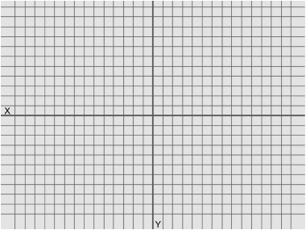
An Experiment and its Replication
An experiment with three conditions:
Participants Rated:
The “close” condition
Attachment to
Siblings
Parents
Home-town
The “intermediate” condition
The “distant” condition
on a
1 (not at all strong) – 7 (extremely strong)
Likert scale
which are averaged to obtain
the dependent variable
attachment
The description given here is a modification of and inspired by the actual experiment executed by
Williams, L.E. and Bargh, J.A. (2008). Keeping One’s Distance. The Influence of Spatial Distance Cues on Affect and Evaluation. Psychological Science, 19, 302-308.

Slide 3
Williams and Bargh (2008) tested:
The replication by Joy-Gaba, Clay, and Cleary (2016) rendered
H₀: µ_{close}= µ_{intermediate} = µ_{distant} ,
that is, the three means are equal
rendering
p-value = .01, that is, smaller than .05,
that is, the means are significantly different
with
m_{close} = 5.61 , m_{intermediate} = , m_{distant} = 4.86
and
η² = .11 ,
that is, the three conditions explain
11% of the variation in attachment,
which is a medium to strong effect of condition
p-value = .79
η² = .00
Joy-Gaba, J., Clay, R., and Cleary, H. (2016). Replication of keeping one’s
distance: The influence of spatial distance cues on affect and evaluation by
Williams L.E. and Bargh J.A. (2008) Psychological Science, 19, 302-308).
Retrieved from https://osf.io/a78bm/

Slide 4
The Replication Crisis
This is only one of 100 psychological experiments of which only about 33% were successfully replicated (OSC, 2015).
This resulted in a reduced trust in science by scientists and society: The replication crisis was born.
Scientists are alerted:
“Society” is alerted:
Estimating the reproducibility of psychological science (OSC, 2015)
An open investigation of the reproducibility of cancer biology research (Errington et al., 2014)
Is psychology a real science? (Is psychologie wel een echte wetenschap, Volkskrant, 12-8-2016)
Public Trust in Science (Rathenau Instituut, August 28, 2018)
Open Science Collaboration. (2015). Estimating the reproducibility of psychological science. Science, 349, 6251. https://osf.io/ezcuj/
Errington, T.M., Iorns, E., Gunn, W., Tan, F.E., Lomax, J., and Nosek, B.A. (2014). An open investigation of the reproducibilty of cancer biology research. eLIFE, 3, e04333. https://elifesciences.org/collections/9b1e83d1/reproducibility-project-cancer-biology
Volkskrant (2016). https://www.volkskrant.nl/columns-opinie/is-psychologie-wel-een-echte-wetenschap~b9978e6c
Rathenau Instituut (2018). Public Trust in Science. https://www.rathenau.nl/en/science-figures/impact/trust-science/public-trust-science

Slide 5
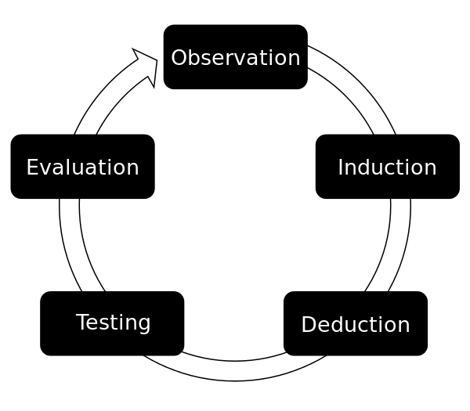
Addressing the Replication Crisis: The Open Empirical Cycle
Notes:
Empirical_Cycle.png: TesseUndDaanderivative work: Beao, CC BY 3.0 <https://creativecommons.org/licenses/by/3.0>, via Wikimedia Commons

Slide 6
Addressing the Replication Crisis: The Open Empirical Cycle
Step 1: Preparation (Observation)
Step 2: Formulate Research Hypotheses (Induction)
Step 3: Planning of Data Collection and Analysis
Step 4: Get Approval from the (Medical) Ethical Testing Committee and Data Management Plan
Step 5: Preregistration and Preregistered Reports
Step 6: Execution of Data Collection and Analyses (Testing)
Step 7: Publish Data and Analyses
Step 8: Write an Open Access Report (Evaluation)
Step 9: Having Your Report Reviewed

Slide 7
Step 1: Preparation
Review literature
Gaps in the literature
Quality of the literature
Variables that are not covered in the literature
Writing it up sharpens thoughts
Write down you research questions:
New questions
Replication studies
Exploratory studies

Slide 8
Step 2: Formulate Research Hypotheses
A research hypothesis is
a verbal representation
of the expected relations
between the variables
resulting from Step 1.

Slide 9
Step 3: Planning of Data Collection and Analysis
Describe population
Describe research design
Describe variables
Derived variables
Statistical model
Formal hypotheses
Power Analyses or Updating
Missing data
Data exclusion
Exploration
Replication

Slide 10
Step 4: (M)ETC and Data Management Plan
Much of the previous three steps
Informed consent forms
Data management plan

Slide 11
Step 5: Preregistration and Preregistered Reports
This is the
pre-data-collection
or pre-data-access
account
of all that has been covered
in the previous four steps.

Slide 12
Step 6: Execution of Data Collection and Analysis
Proof that data collection
takes place after preregistration.
Proof that data access
takes place after preregistration.

Slide 13
Step 7: Publish Data and Analyses
Data and analyses should be FAIR,
Findable,
Accessible,
Interoperable,
Reusable,
that is, accessible to all interested parties.
Most of the remainder of this presentation
discusses how that can be achieved.

Slide 14
Step 8: Write an Open Access Report
Include a link to your pre-registration.
Include a link to your data-analyses repository.
Publishing open access is an important feature of open science.
Being able to unobstructedly obtain everything (also the report) related to a research project will enable anyone to:
benefit from your research
reuse (parts) of your research
engage in a fully informed discussion about your research.
This should both increase the impact of your research and increase the trust in your research and the trust in science in general.

Slide 15
Step 9: Having your Report Reviewed
May lead to
changes in your report
and possibly
deviations from your pre-registration.
These deviations can be highlighted
in your report using footnotes.

Slide 16
Continued: Step 7: Publish Data and Analyses
Opening, that is, publishing, your data, analyses input, analyses results, and interpretation of the results
Others can:
- Inspect your data
- Reproduce your analyses (and get all the information, cf., the missing m_{intermediate} in Williams and Bargh, 2008)
- Read your interpretation of the analyses
- Data are available for meta analyses and “null-findings” become accessible
Being open will add to the trust in your research, that of the group to which you belong, and science in general

Slide 17
Open the Data Analyses of your Thesis
… can easily be done using:
… applies to:
All research based on quantitative data

Slide 18
Open Data Analyses should be FAIR
Findable: Place your data and analyses in a public repository
Accessible: Make certain your data come with a codebook, and your analyses with annotations
Interoperable: Ensure that data and analyses can be opened on different types of computers
Reusable: Include a license, that is, make clear what others are (not) allowed to do with your data
For further elaboration and information see “How to make your data FAIR” (Research Data Management Support, Utrecht University). To verify if your data is FAIR already, see FAIR Cheatsheets: to publish your research data and software FAIR - Research Data Management Support - Utrecht University (uu.nl).

Slide 19
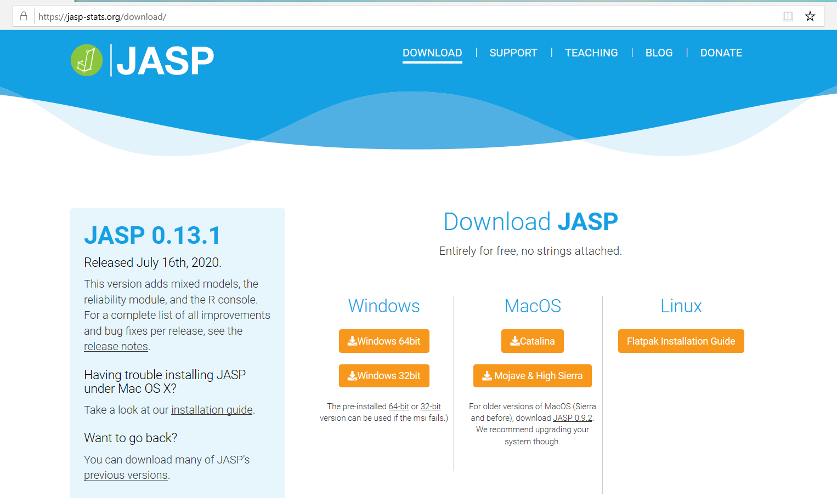
Interoperable
A Crash Course into JASP
How to use JASP

Slide 20
Accessible
Joy-Gaba, Clay, and Cleary (2016) replicated Willams and Bargh (2008)
The replication data and analyses are contained in openJoyGaba.jasp

Slide 21
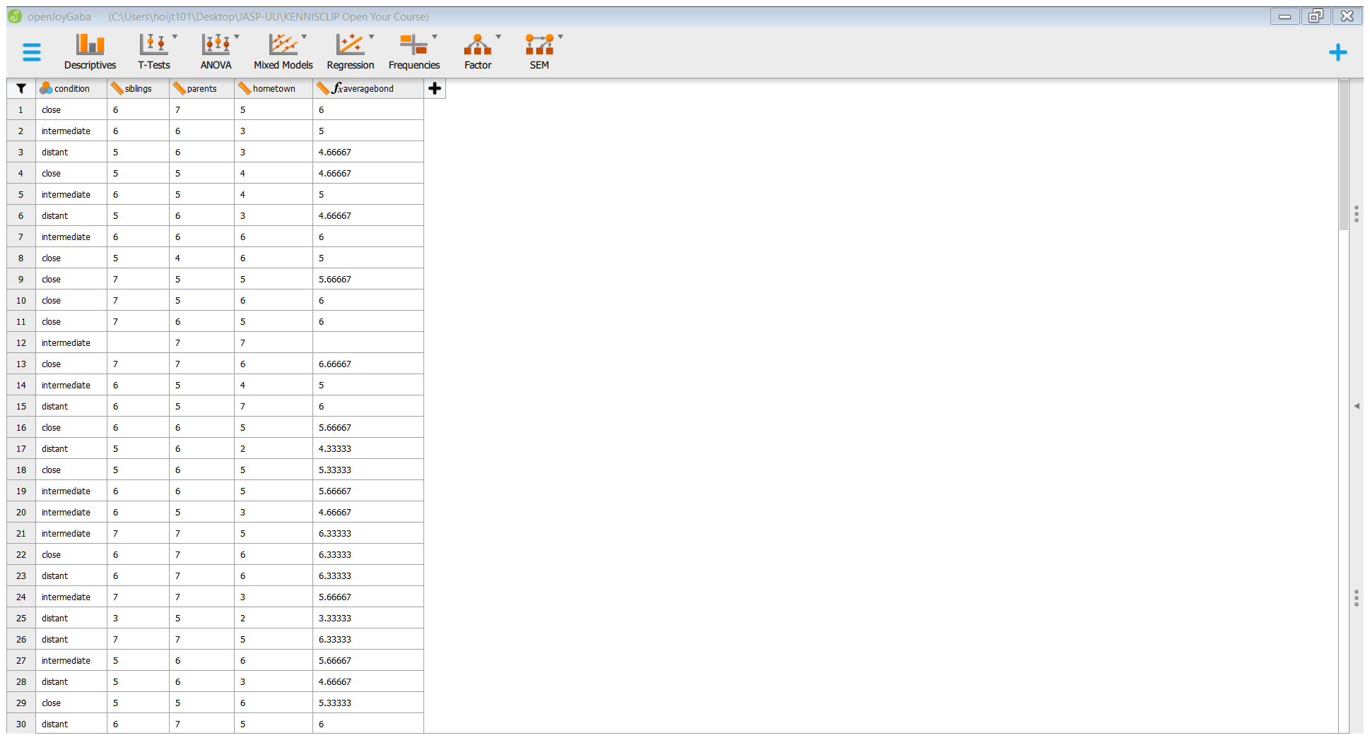
The Data Collected by Joy-Gaba, Clay, and Cleary (2016)

Slide 22
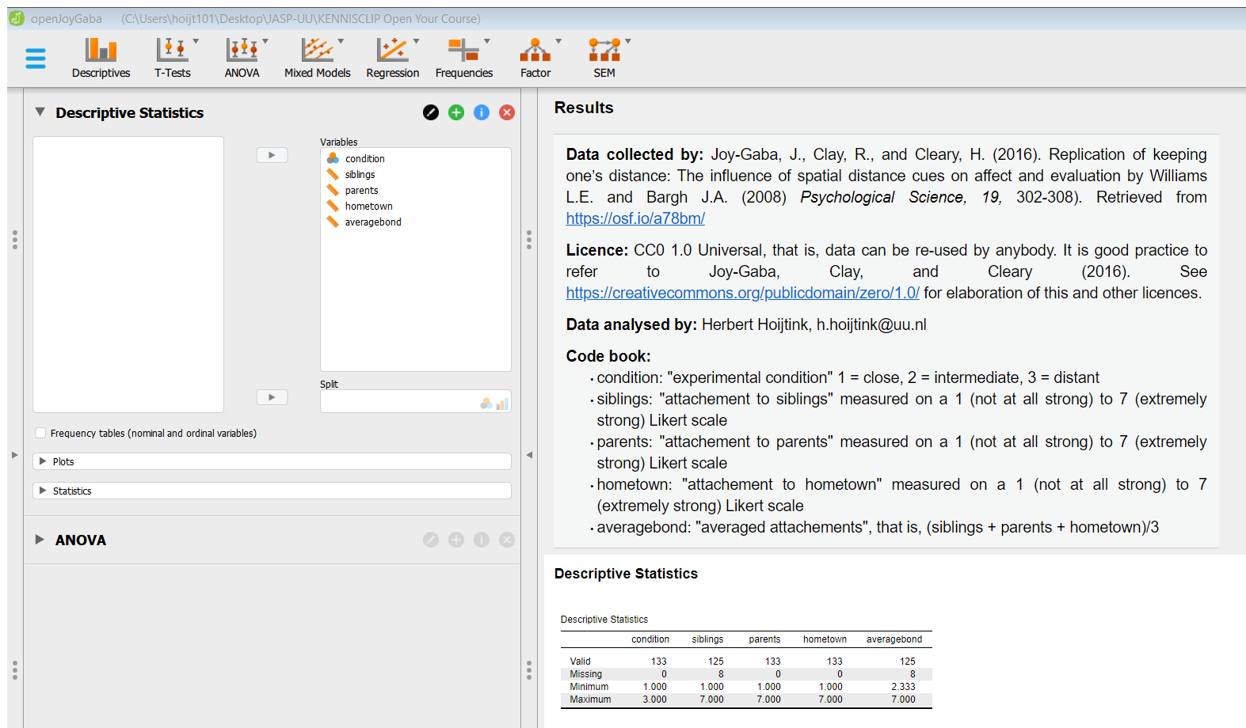
Data collected by, License, Data analyzed by, Code book, and Descriptive Statistics

Slide 23
Include Annotations of your Analyses
Explain using annotations which analyses were executed and what your interpretation of the outcomes was

Slide 24
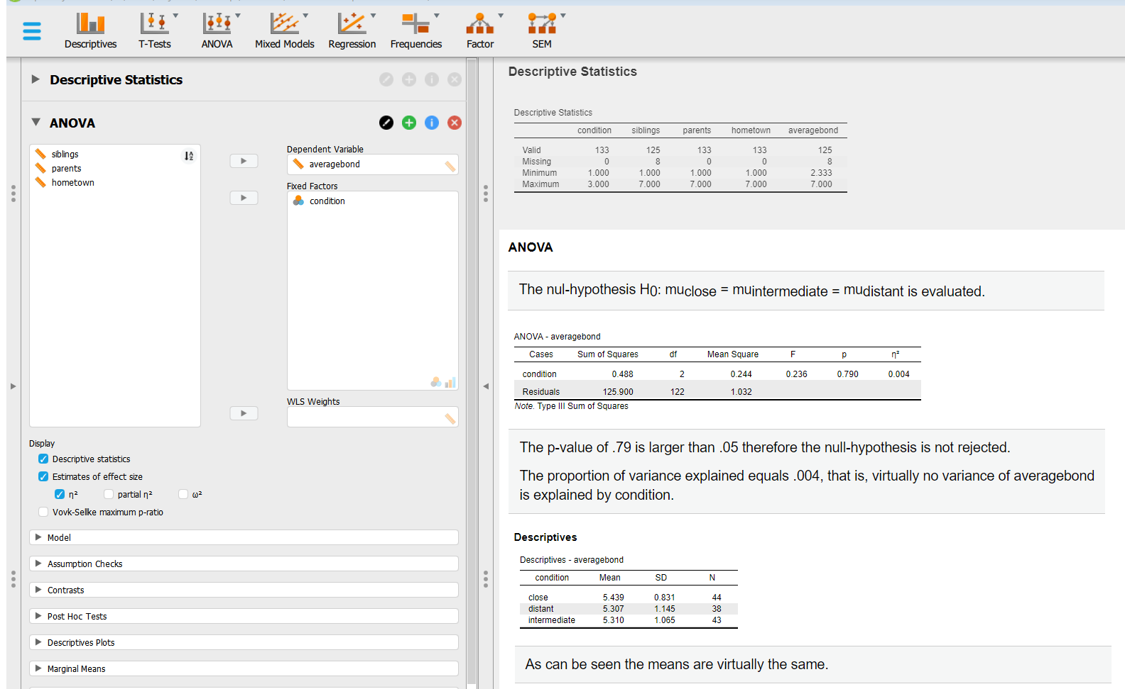
Annotated Analyses

Slide 25
By doing this you Create an Annotated Logbook of your Analyses
As shown on the previous two slides JASP tracks the analyses that you execute
There is a Descriptive Statistics button on the left side of the screen
rendering the data overview on the right side of the screen
There is an ANOVA button on the left side of the screen
rendering analyses with annotations on the right side of the screen
If you continue executing analyses and adding annotations to your analyses, you create a logbook that will
help you to track your traces, therefor it will be completely clear to others:
Which analyses you did
How you did them (this should shortly be explained in the annotations)
How you interpret the results (this should shortly be explained in the annotations)
In this manner you make the data and analyses from your study accessible
Notes:
It is important to highlight that if you continue to add analyses, you create an annotated logbook of all the analyses you did. There are now Descriptive and ANOVA buttons in your JASP file, but you could continue and add other buttons. This will enable anybody opening your JASP file to see: which analyses you did, how you did them, and how interpreted the results. In this manner you adhere to the A in FAIR, and make your data and analyses ACCESIBLE.

Slide 26
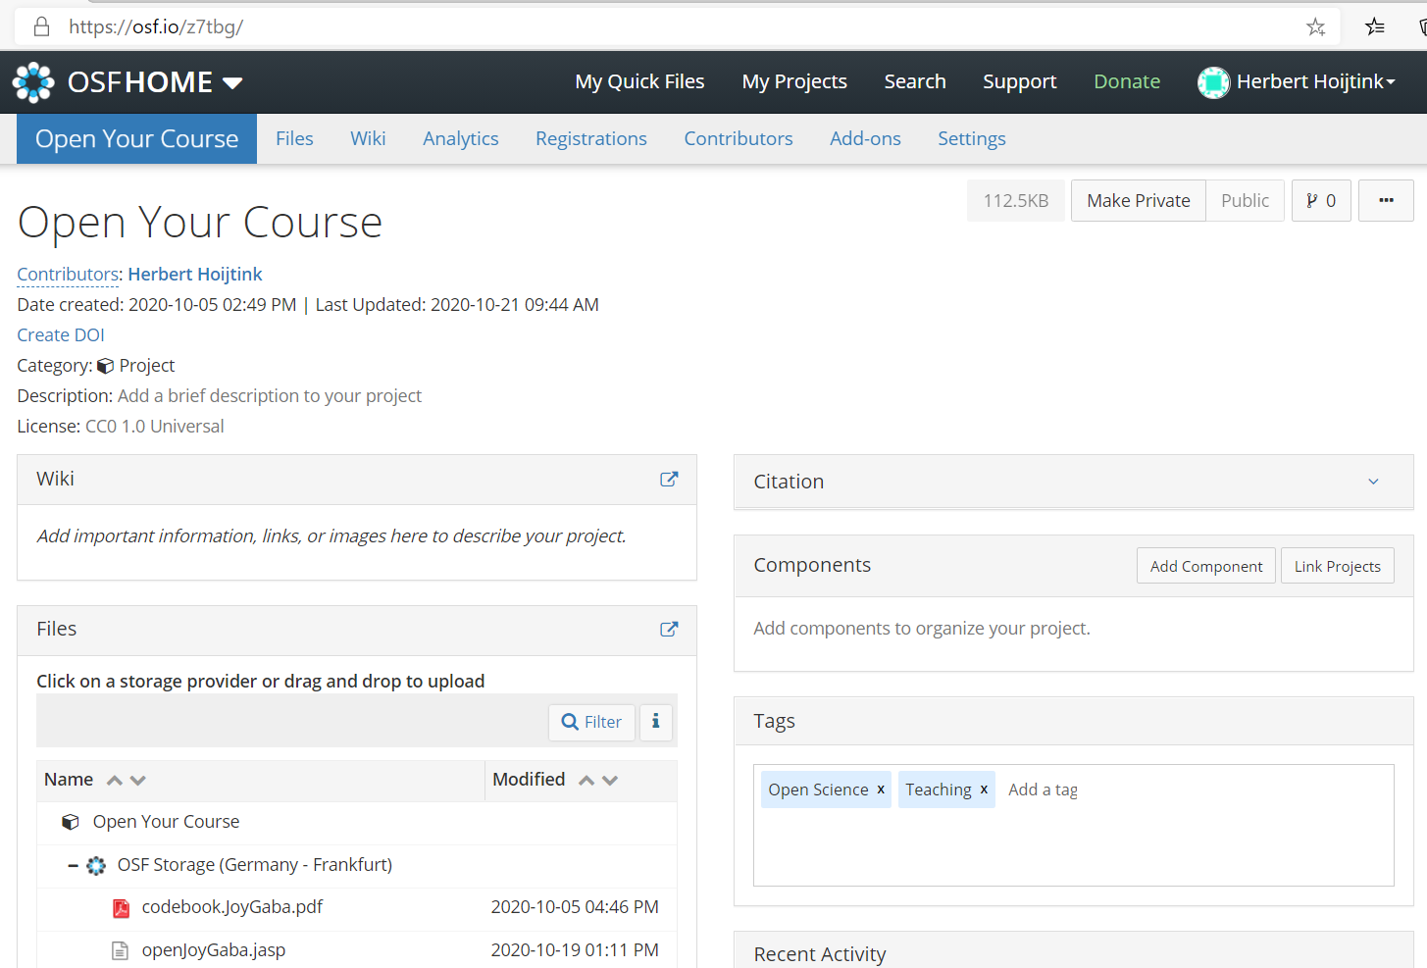
Findable Using the Open Science Foundation

Slide 27
Reusable
Fully Open Data Analyses: Include the CC0 1.0 Universal License With Your Data
The license can be included in your mydata.jasp file.
The CC0 1.0 Universal Public Domain Dedication:
Is truly open, that is, anybody can use your data for whatever purpose
If you include a reference to a paper or your contact information in the mydata.jasp file, anybody using your data can refer to you
The CC0 1.0 Universal Public Domain Dedication: https://creativecommons.org/publicdomain/zero/1.0/

Slide 28
The Conflict between Fully Open Data Analyses and Privacy Regulations
Personal data can only be published if privacy is guaranteed. One way to achieve this is, if data are truly anonymized (General Data Protection Regulation: https://gdpr-info.eu/).
Truly anonymized data is no longer personal data and thus no longer subject to the GDPR
It involves the complete and utter removal of all personal identifiers in a database
Anonymized data can no longer be attributed to any particular individual by any means
If anonymization cannot be achieved, you can still “Open your Analyses” by publishing only
your code book, results, references, license and annotated analyses (these are often called
meta data). This can be done using a myresults.html file that can be created based on your
mydata.jasp file.
This page was constructed using quotes and input from Handling Personal Data in Research (Utrecht University)

Slide 29
The Conflict between Fully Open Data Analyses and your Future Research Plans
Therefore, you may want to impose restrictions on the use of your data, e.g., “can only be used to reproduce the analyses you executed”
However, this cannot be arranged via the application of a license, data are often considered to be facts and facts cannot be copyrighted (OpenAIRE)
In such cases you can consider publishing only a part of your data, e.g., only the data and analyses that are used in a specific research report (but do provide complete meta data, most importantly, the code book of your complete data set)
Then the unused data are only available for you and thereby you avoid being scooped out of your next paper
OpenAIRE: https://www.openaire.eu/how-do-i-license-my-research-data

Slide 30

Links to …
JASP
A Crash Course into JASP
How to use JASP
REPOSITORIES
Open Science Foundation
Yoda (Utrecht University)
LICENCES
Creative Commons
OpenAIRE
ANONIMIZED AND FAIR DATA
How to Make you Data FAIR
Handling Personal Data
FAIR Cheatsheets
General Data Protection Regulation
OPEN SCIENCE
Open Science Community Utrecht
Summer school ‘Open Science Bootcamp’

Slide 31
Links to …
THE WORKSHOP MATERIALS
Open your Course/Bachelor Thesis

Slide 32
How To …
Use one of the example data sets that downloaded with this presentation: data.sav, data.txt, or data.csv.
Execute each of the steps in the following slides.

Slide 33
How to Create a mydata.jasp File
Make certain that JASP is installed on your computer. If not, install it from https://jasp-stats.org/download/
If JASP is installed, start the program.

Slide 34
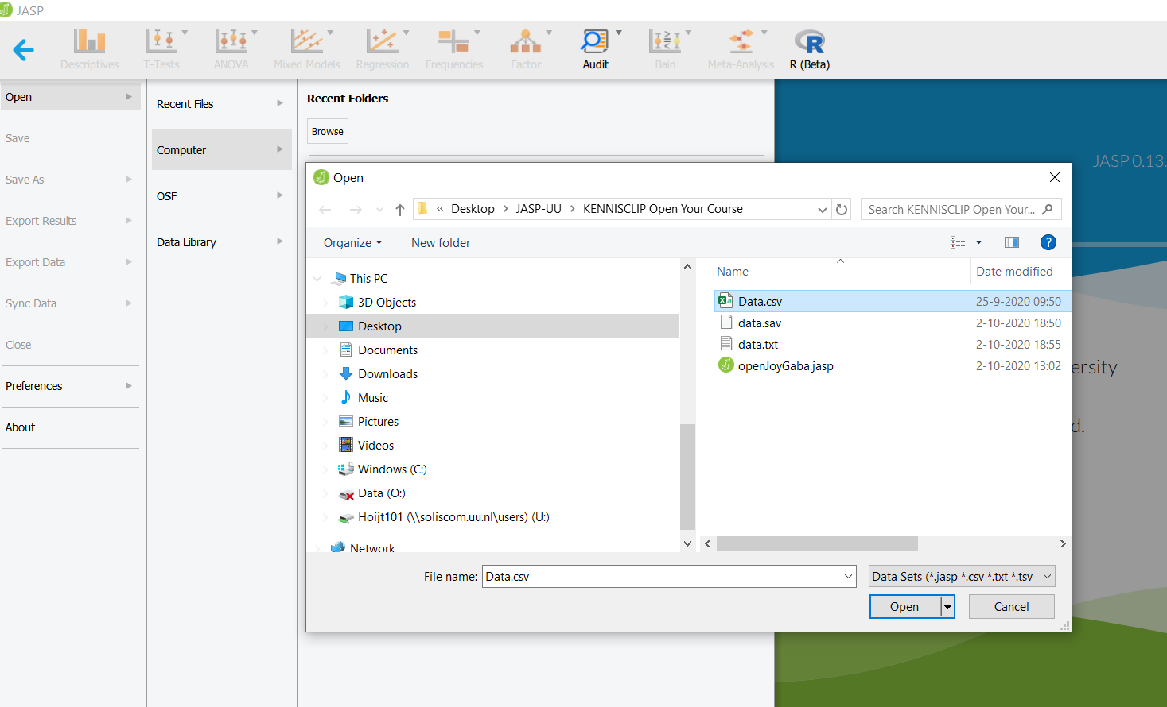
Open a .csv, .sav, or .txt file containing your data
1
2
3
4
5
6

Slide 35
After the data spreadsheet opens
Click on Descriptives to open the analysis screen

Slide 36
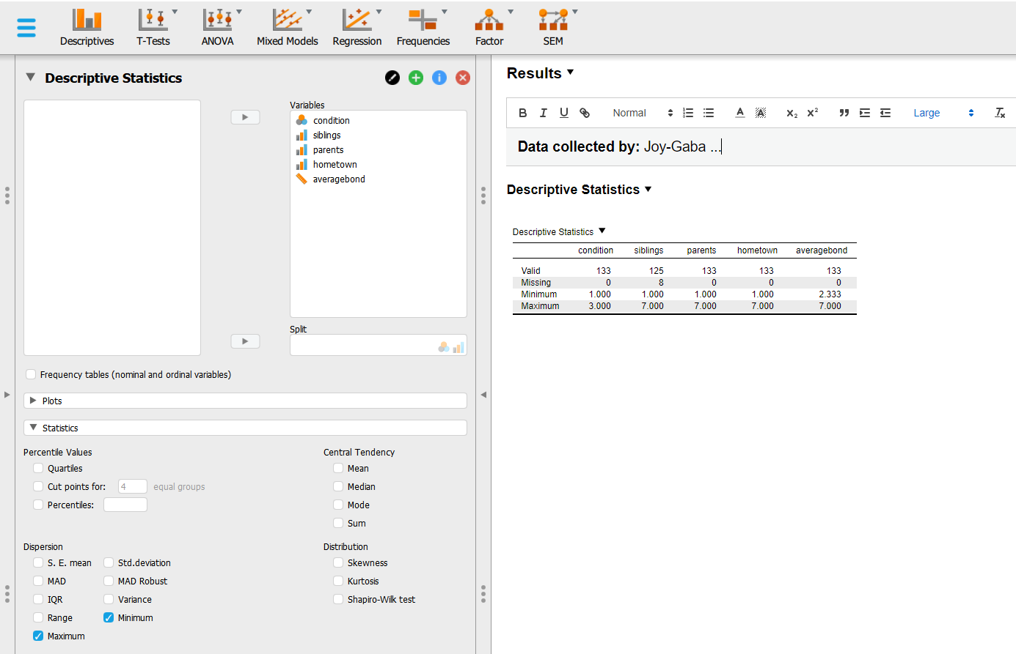
Execute your Analyses – Start with Simple Descriptives – and Add Notes to your Results
1
4. Click the black triangle and choose annotate
5. Use the lay-out options such as bold face, font size, etc.
2
3
Notes:
Laat de cirkels één voor één verschijnen

Slide 37
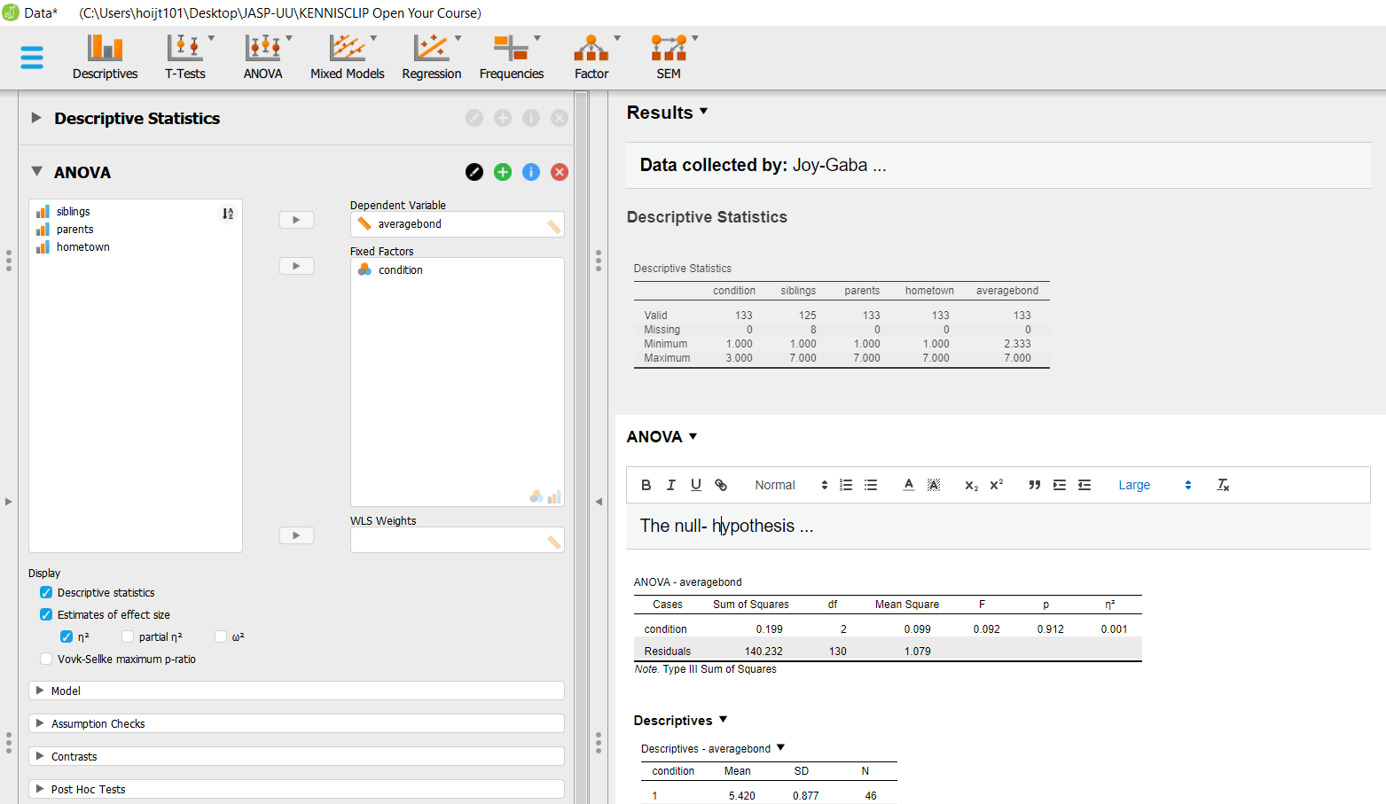
Continue your Analyses with an ANOVA and Add Notes to your Results
1
2
4: click the black triangle and choose annotate
5
3
Notes:
Laat de cirkels één voor één verschjijnen

Slide 38
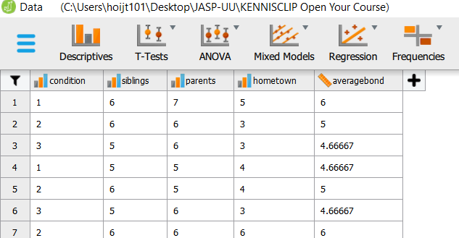
Please note that …
Currently you have to make a different mydata.jasp file for each selection of cases you make, e.g., before filtering
(marked by the red ellipse), and before deleting or adding cases. Otherwise, all your analyses will be based on the
latest selection of cases created.
This will be remedied in one of the future JASP releases.
A knowledge clip explaining the main features of JASP (selecting cases, computing variables, recoding, opening
a data file, saving a mydata.jasp file, executing analyses, getting help, etc.) can be found at https://osf.io/z7tbg/
A virtually complete elaboration of all the features of JASP can be found at https://jasp-stats.org/how-to-use-jasp/
Notes:
De crash course is er nog niet!

Slide 39
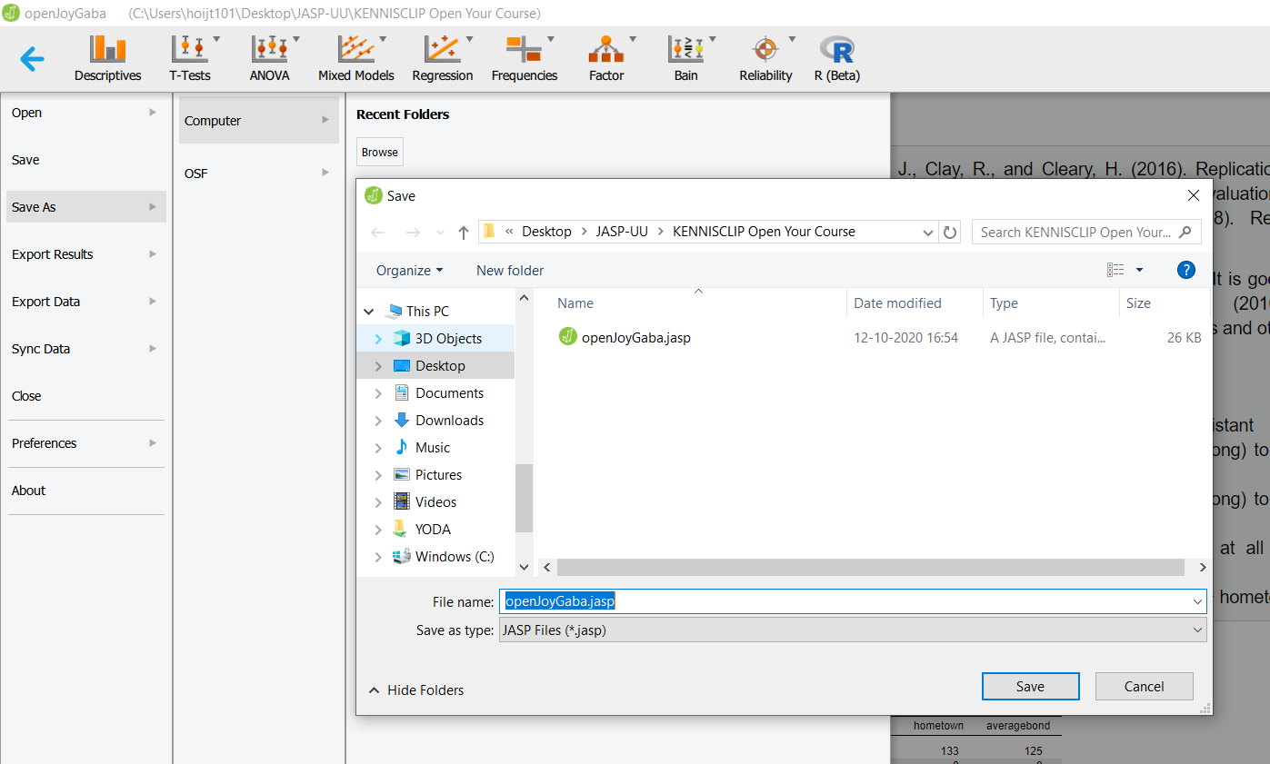
Save as a mydata.jasp File on your Computer – contains data, analyses input and annotated analyses results
2
3
1
4
5
6

Slide 40
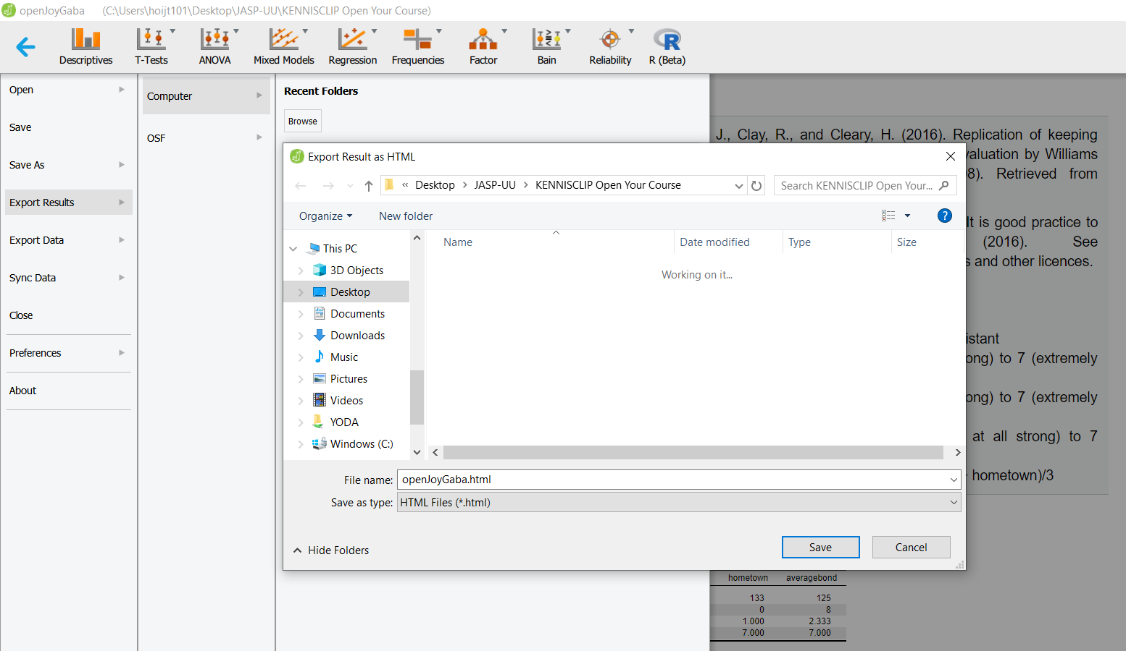
Save a mydata.jasp file as a myresults.html File on your Computer – only contains the annotated results
2
3
4
1
5
6
Notes:
Laat de cirkels één voor één verschijnen

Slide 41
How to Make your Data Analyses Findable Using the Open Science Foundation

Slide 42
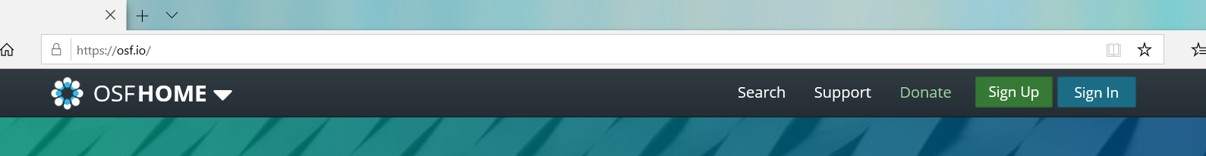
Create a Project to Store your Data at the Open Science Foundation in Four Simple Steps
1
2

Slide 43
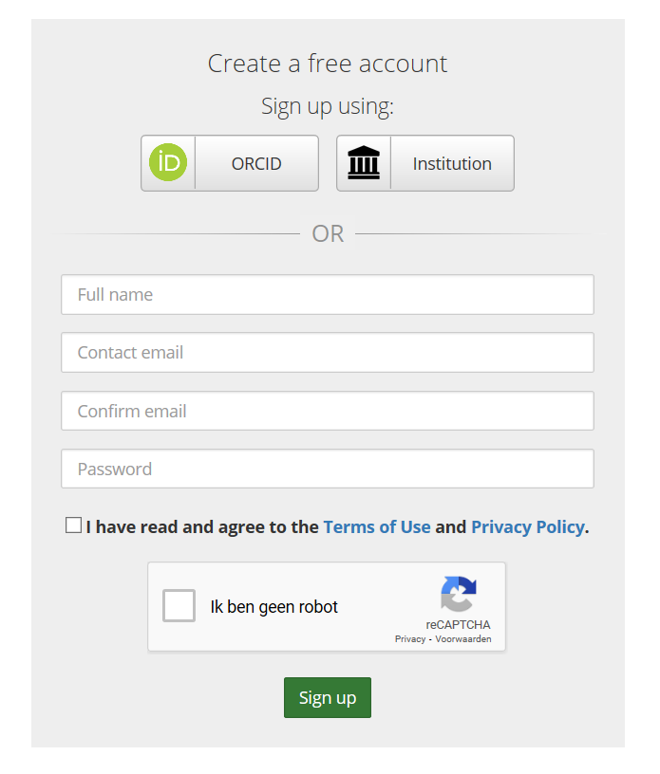
Step 1: Create a Free Account
1
2
3
4

Slide 44
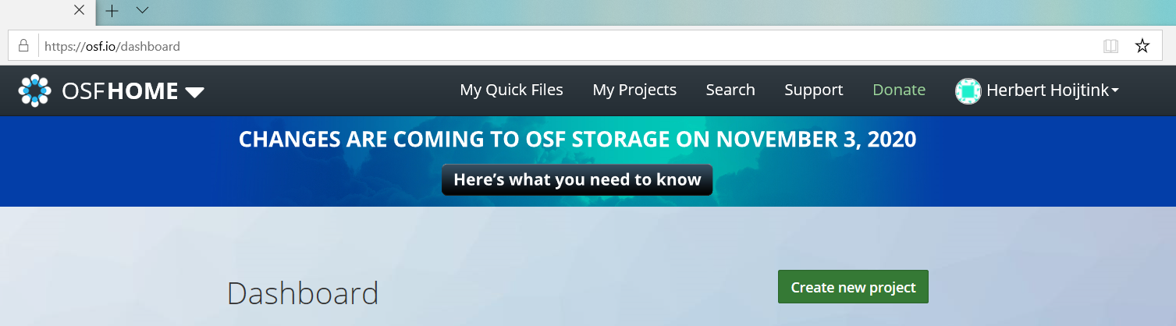
Step 2: Create a New Project

Slide 45
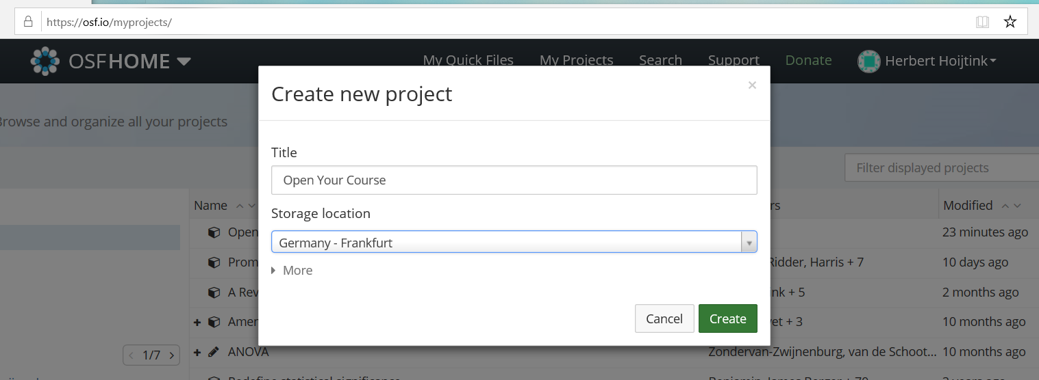
Step 2: Create a New Project (continued)
1
2
3

Slide 46
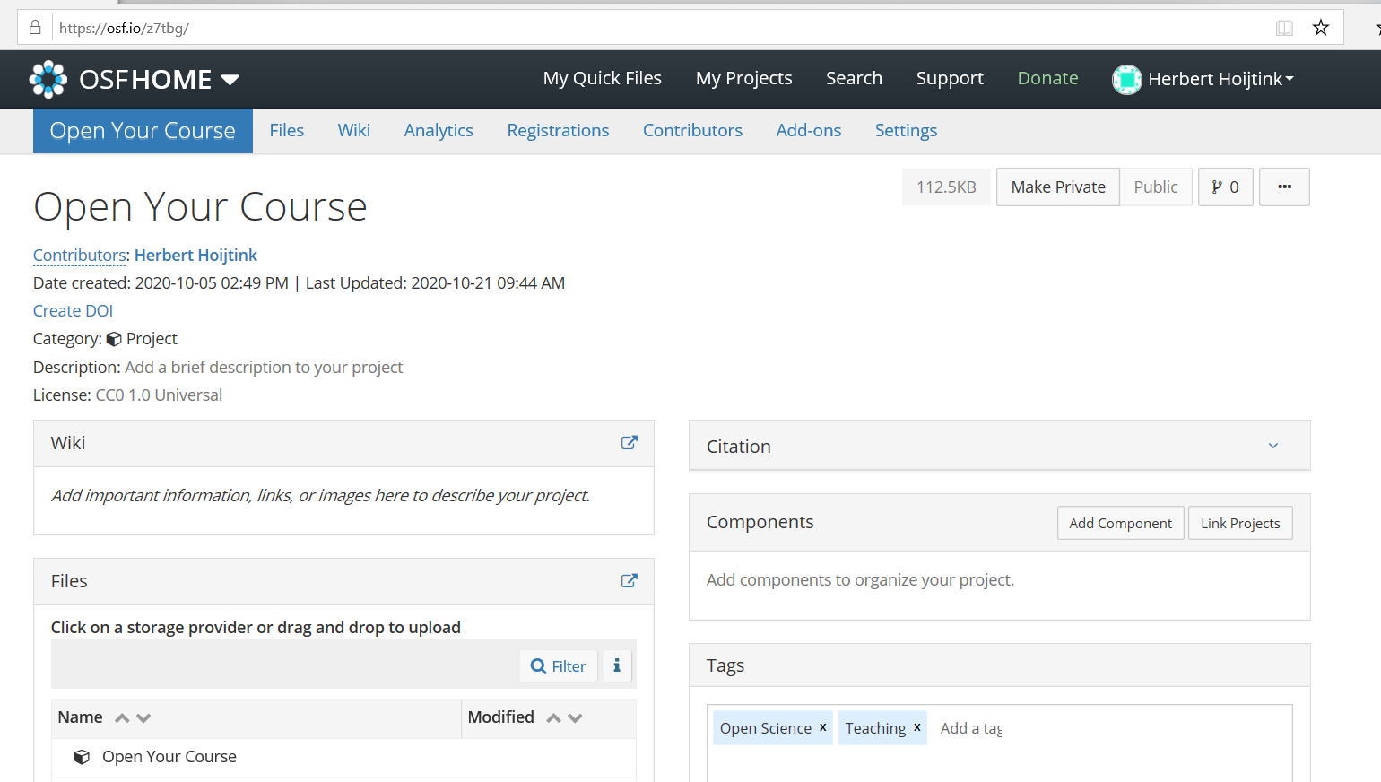
Step 3: Make your Project Publicly Available
1: anybody can surf here to access your data analyses if …
2: … you make your project publicly available
3
4
Notes:
Laat de cirkels één voor één verschijnen

Slide 47
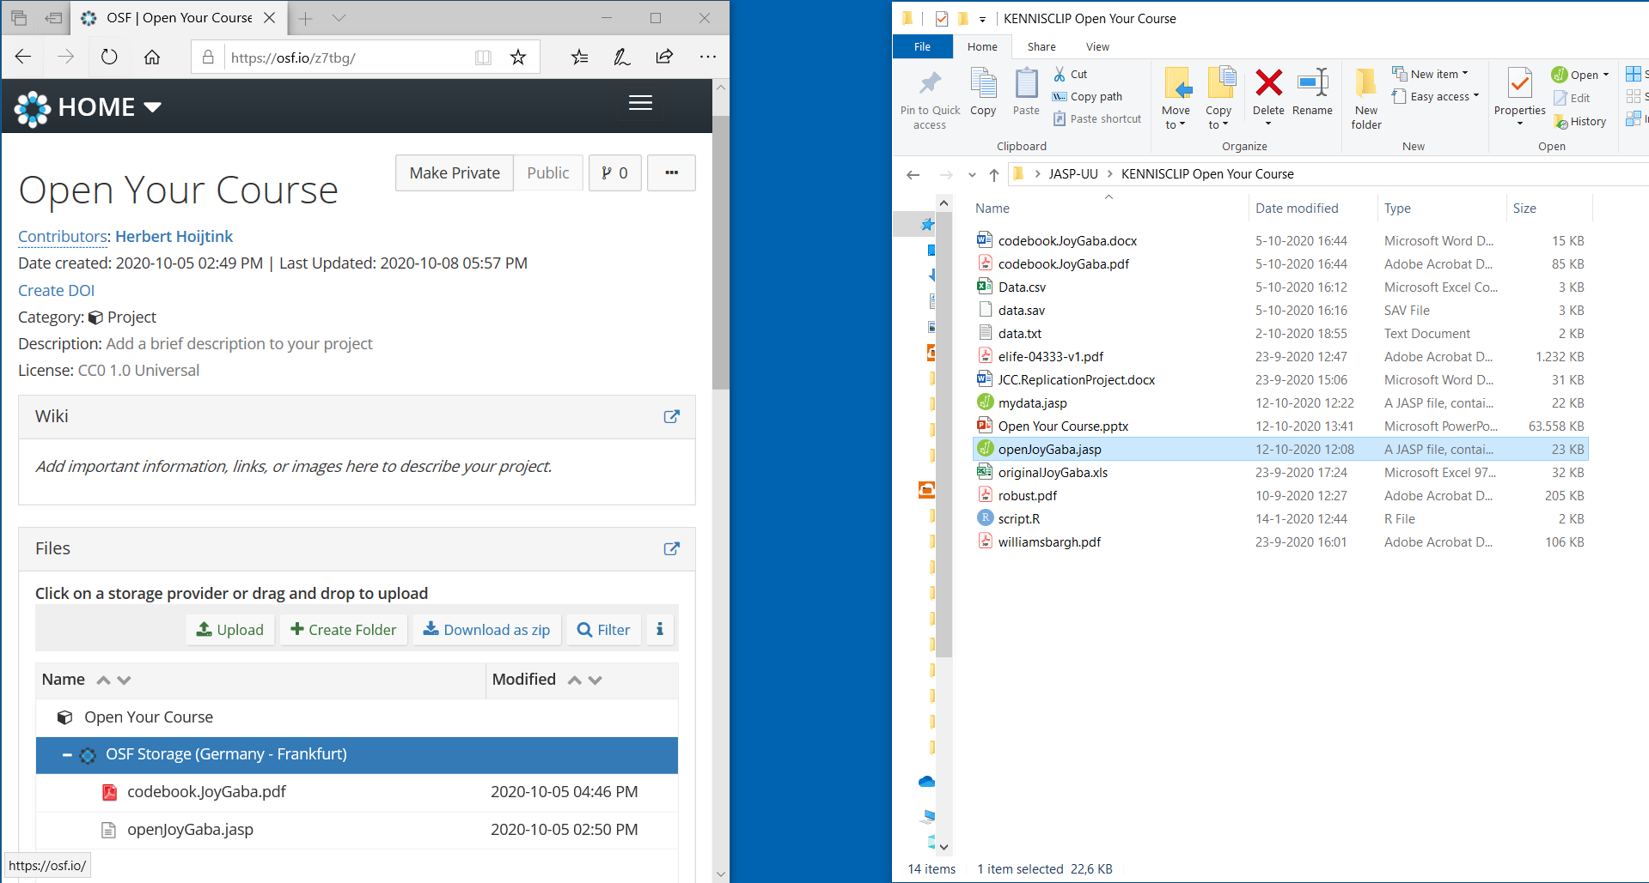
Drag your Data and other Relevant Files into the Project you Created
Drag files onto the blue bar
to add them to your project
Notes:
Pick up all my stuff from osf to try yourself.

Slide 48
The End

